Slide 1
Bootiful Spring AI
by Josh Long
(with slides produced by Dr. Mark Pollack, creator of Spring AI)
me:
josh@joshlong.com
https://youtube.com/@coffeesoftware
code:
https://github.com/joshlong-attic/2025-04-02-arcofai.git

Slide 2
Journey to generative AI
1956 - Artificial Intelligence
CS field in developing intelligent machines that can think and learn like humans.
Artificial Intelligence
Machine Learning
1997 - Machine Learning
Systems that learn from existing data to make decisions and predictions.
Deep Learning
Generative AI
2012 - Deep Learning
Artificial Neural Networks, mimic the human brain structure, that can recognize complex patterns in data.
2021 - Generative Learning
Systems that can generate new data, such as images, videos, and audio.
Notes:
https://redblink.com/generative-ai-vs-machine-learning-vs-deep-learning/

Slide 3
Why is generative AI unique?
No training required
Human Language as the interface
No need to be a data scientist

Slide 4
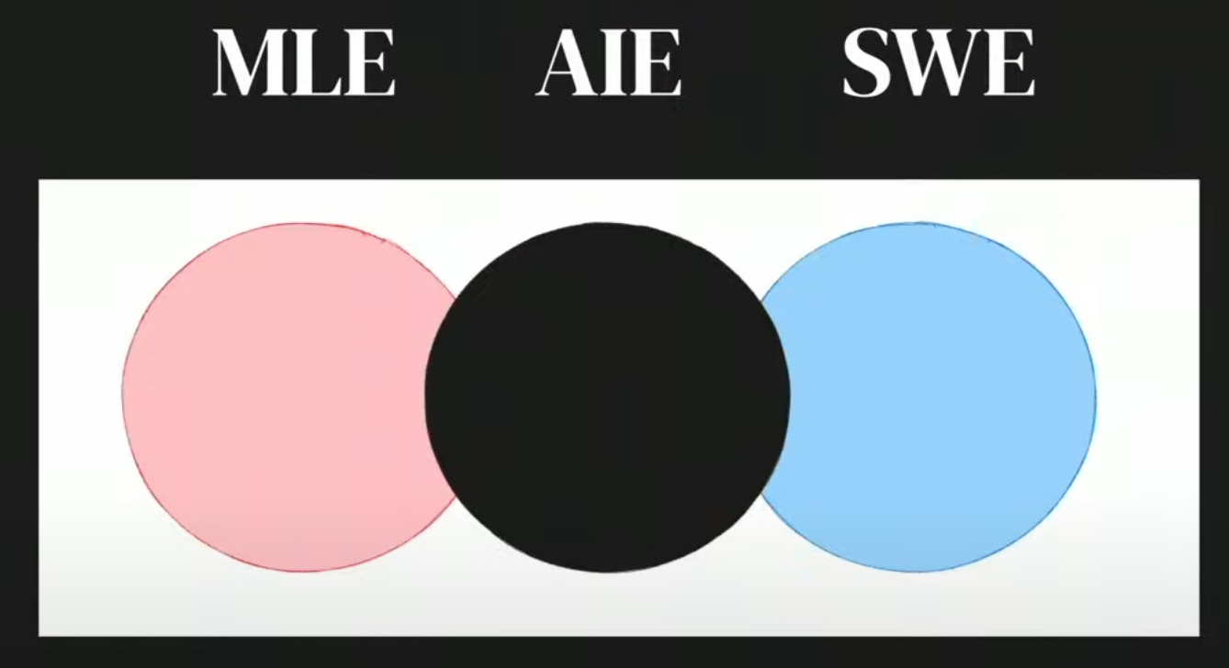
Evolution of an AI engineer…

Slide 5
What is Spring AI?
An Application Framework for
AI Engineering
Portable AI Service Abstractions
Developer Productivity
Keeping up with the latest advancements

Slide 6
Generative AI patterns..
Align responses to goals
System Prompt
Stateless APIs
Chat Memory
Not aware of your APIs
Tool Calling
Not trained on your data
Prompt Stuffing
Limited context size
Vector Store + RAG
Prone to hallucinations
Evaluation
Notes:
we will show you how Spring AI can help you write practical AI applications taking these limitations into account

Slide 7
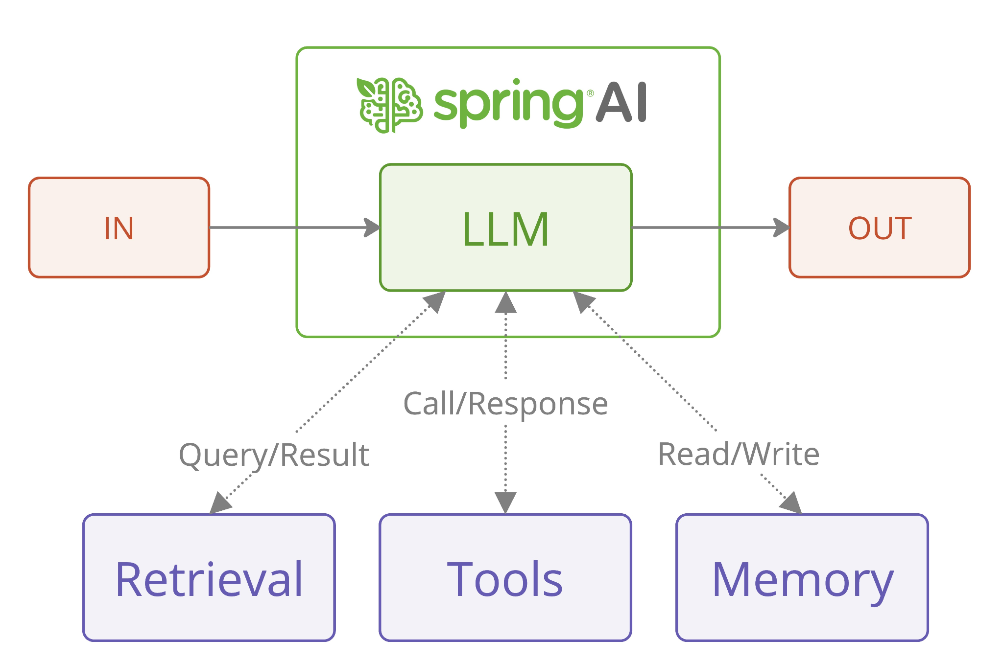
The big picture..
Notes:
we will show you how Spring AI can help you write practical AI applications taking these limitations into account

Slide 8
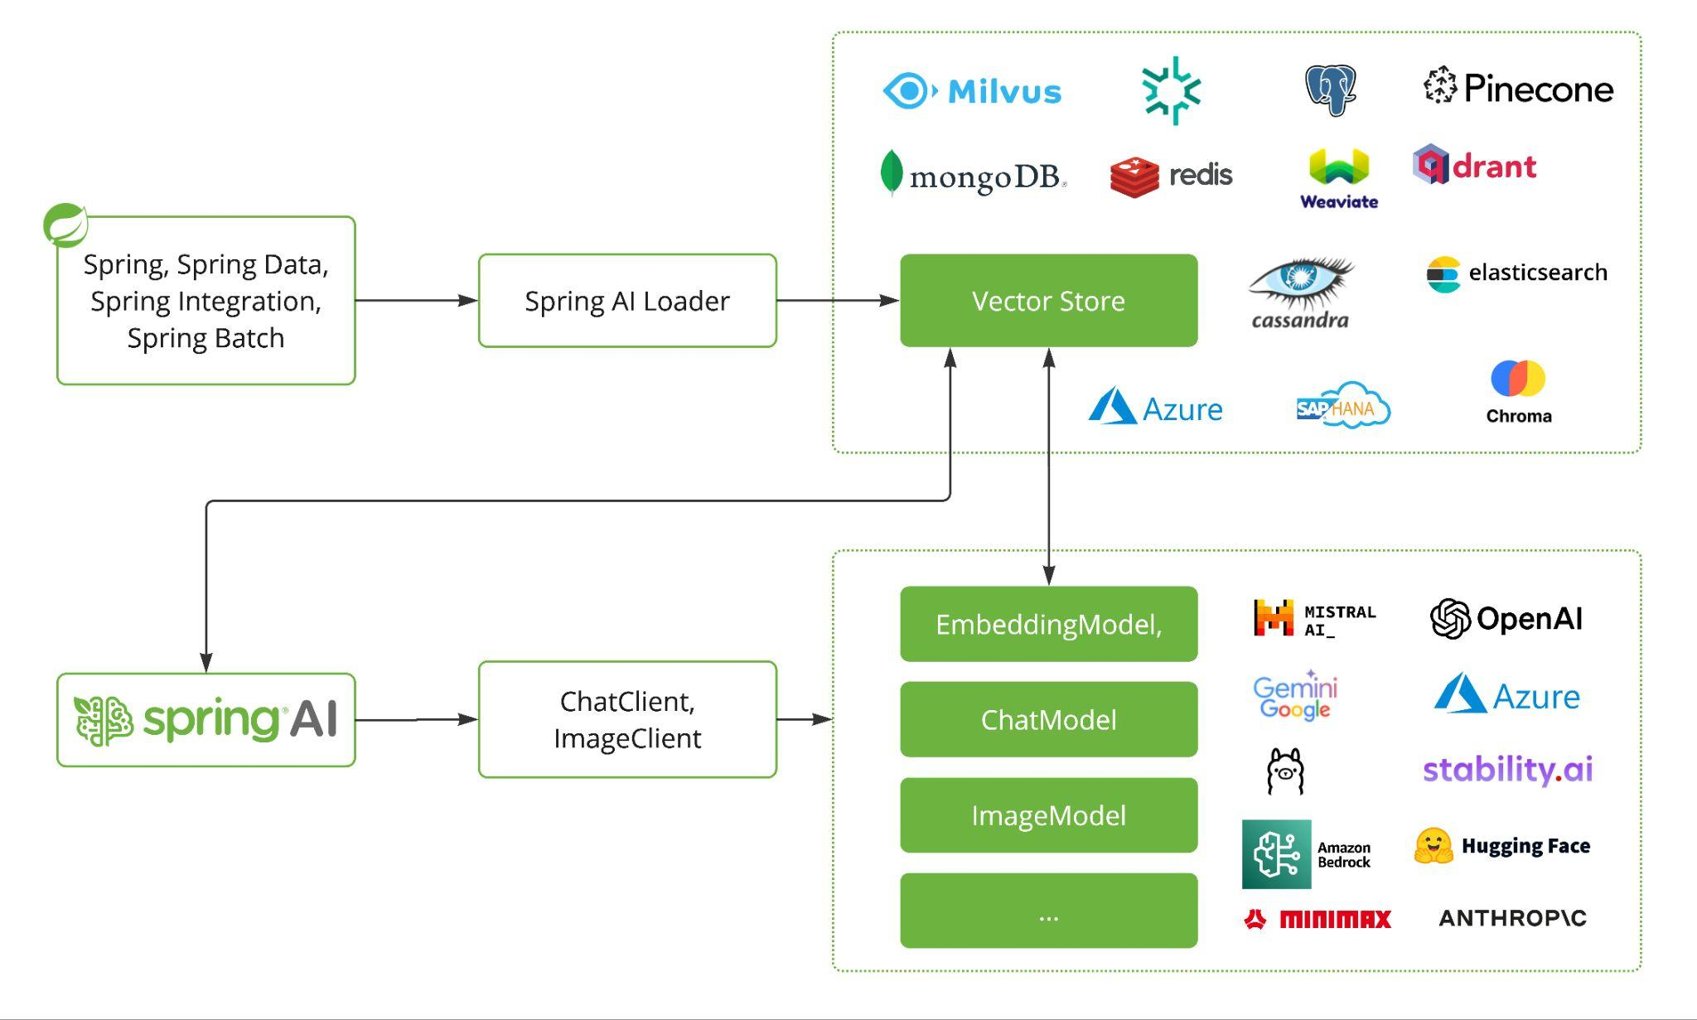
The big picture..
Notes:
Spring AI is the missing ingredient in the Spring stack for AI engineering.
And it's conceptually very easy to understand. There are a few key portable service abstractions for vector stores, and AI models, supporting common patterns. It should make any Spring developer feel right at home.

Slide 9
Meet the dogs…
(demo.)

Slide 10
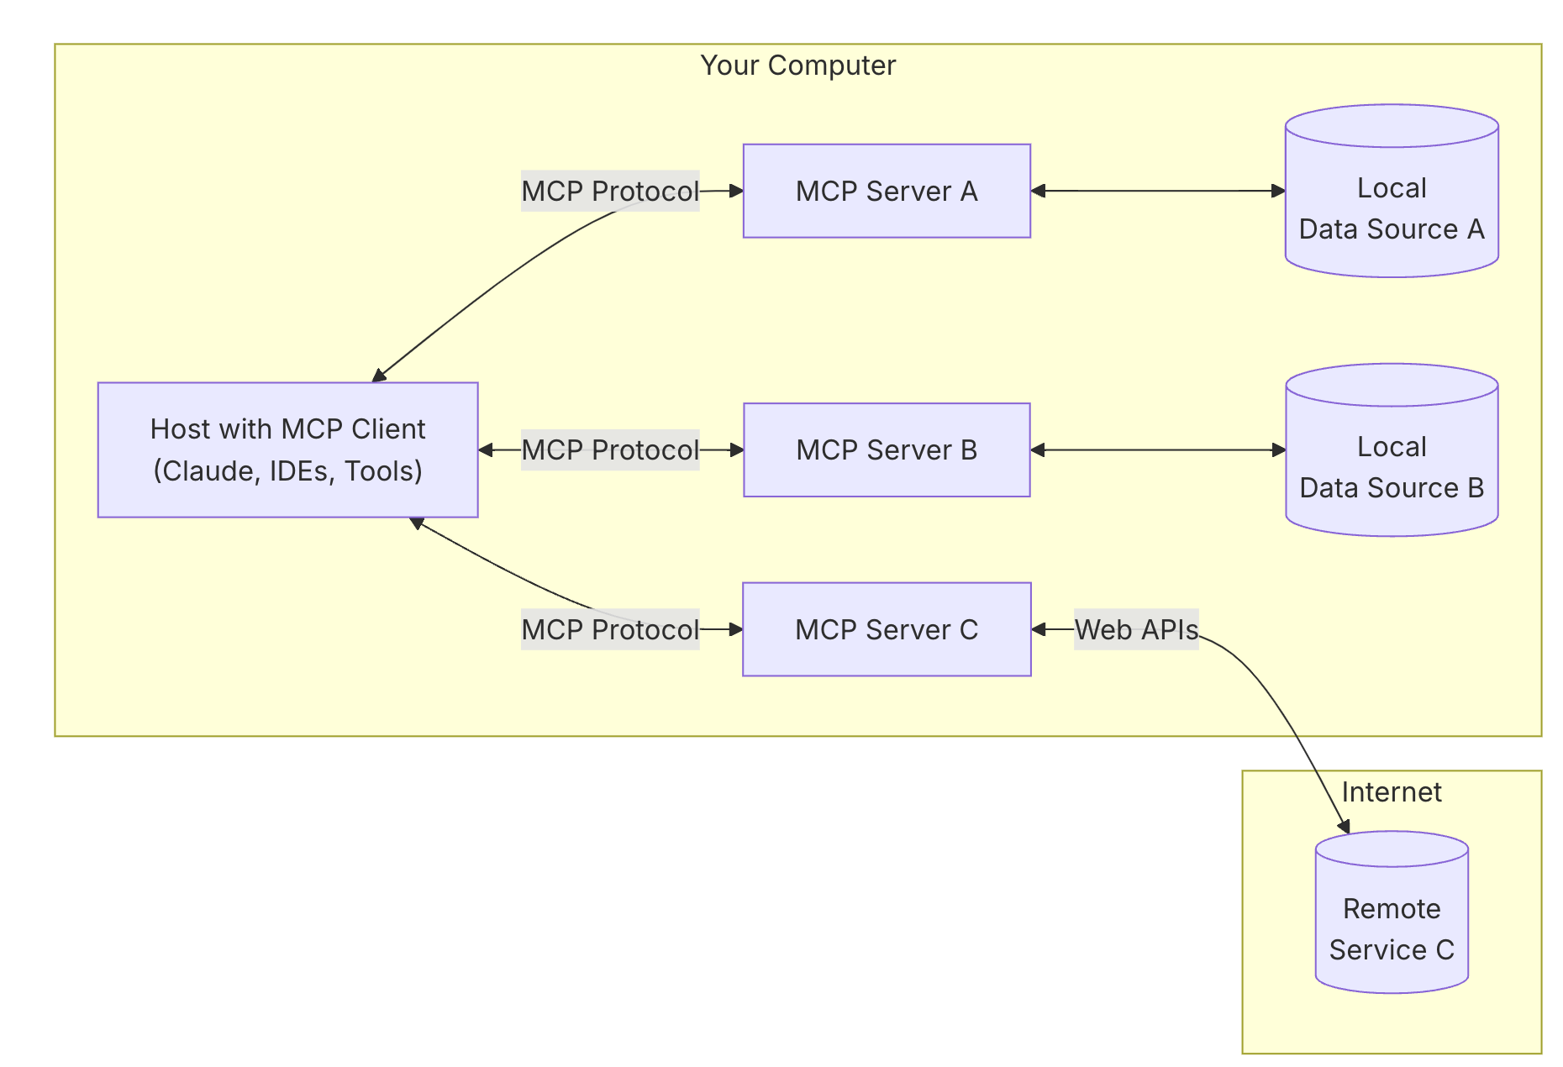
Model Context Protocol (MCP)
Unified way to connect AI models to different data sources and tools
Interoperable
Bidirectional
Local vs Remote
Capabilities
Tools
Resources
Prompts
Sampling
https://modelcontextprotocol.io
Notes:
we will show you how Spring AI can help you write practical AI applications taking these limitations into account

Slide 11
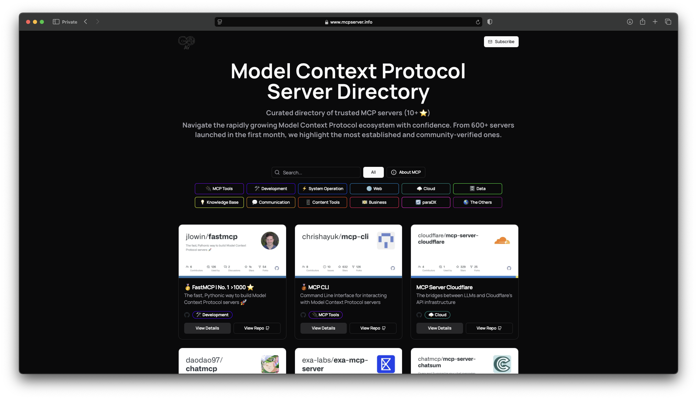
A new toolbox…

Slide 12
SOA for AI? (SOAI?)
Schema?
Integration?
Orchestration?

Slide 13
Scheduling with MCP…
(demo.)

Slide 14
“Agentic”
“Leverages an Al model to interact with its environment in order to solve a user-defined task”
Combines Planning & Memory & Actions to fulfill the tasks
Al Model
Handles reasoning and planning
Decides which Actions to take
Tools
What an Agent is equipped to do
Interacts with its environment
Notes:
(The most common AI model found in Agents is an LLM, which takes Text as an input and outputs Text as well).
Some tasks will require very specific Tools to be crafted, while others may be solved with general purpose tools

Slide 15
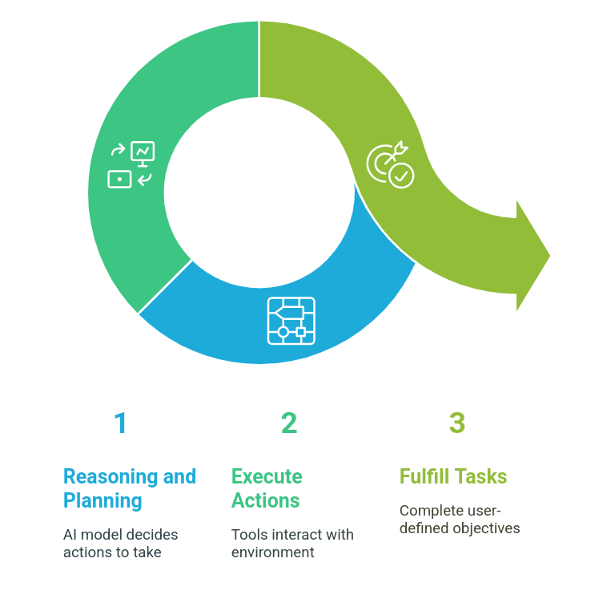
Lifecycle…

Slide 16
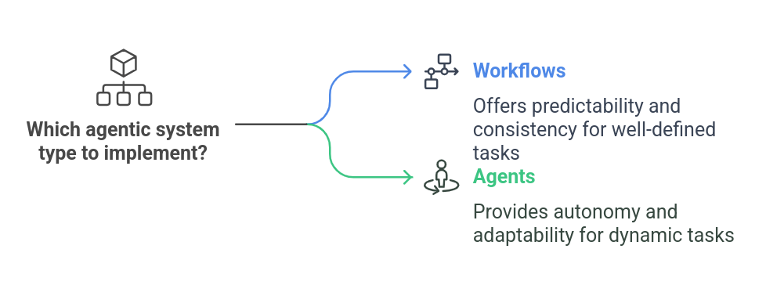
Not all agents are equal..

Slide 17
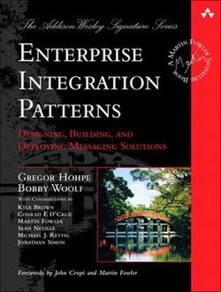
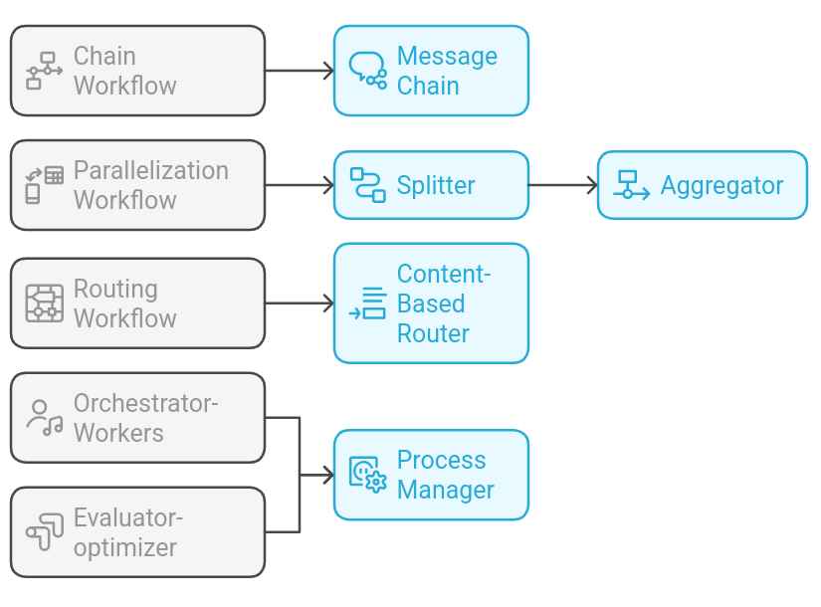
Agent workflow patterns..
https://spring.io/blog/2025/01/21/spring-ai-agentic-patterns
Notes:
Dual-LLM process where one model generates responses while another provides evaluation and feedback in an iterative loop
Chain Workflow ↔ Message Chain
Sequential processing where each step's output feeds into the next.
Parallelization Workflow ↔ Splitter + Aggregator
Tasks are broken into independent parts and later merged.
Routing Workflow ↔ Content-Based Router
Directs different inputs to specialized processing paths.
Orchestrator-Workers/ Evaluator-optimizer ↔ Process Manager
A central orchestrator manages multiple worker agents.
Iterative improvement where one step generates, and another evaluates.

Slide 18

Prancer the agent?

Slide 19
Agentic routing…
https://github.com/joshlong-attic/2025-04-02-arcofai
(demo.)

Slide 20
Production worthy AI…
Today (Actuator, GraalVM, virtual threads, Project Panama, etc.)
vs.
Tomorrow (Project Valhalla, Vector API, etc.)

Slide 21
Production worthy AI
(demo.)

Slide 22
Resources
Docs
https://docs.spring.io/spring-ai/reference/index.html
https://docs.spring.io/spring-ai-mcp/reference/overview.html
https://spring.io/blog/2025/01/21/spring-ai-agentic-patterns
Demos
https://github.com/spring-projects/spring-ai-examples
https://github.com/joshlong-attic/2025-04-01-arcofai.git
Notes:
we will show you how Spring AI can help you write practical AI applications taking these limitations into account

Slide 23
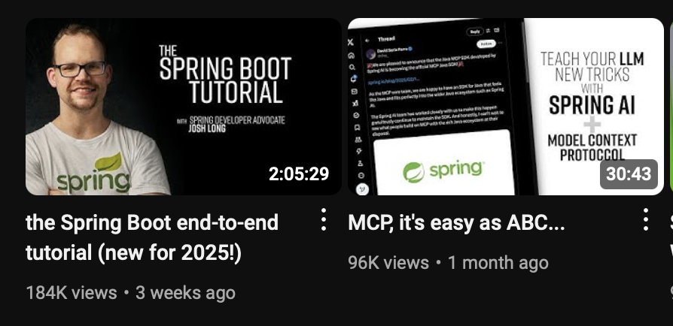
youtube.com/@coffeesoftware
Notes:
we will show you how Spring AI can help you write practical AI applications taking these limitations into account

Slide 24

Thank You.
(any questions?)

